Slide 1
Gender
& Precarity
in contemporary Italy
LABOR,
VALUE,
SOCIAL REPRODUCTION
Laura Fantone
University of California, Berkeley 2013
Notes:
Bringing together an analysis of precarity movement and a study of an emerging generation of feminists in Italy
multiple dimensions of precarity impacting cultural and social reproduction

Slide 2
Different Precarities
an audio-visual lecture on Gender and Precarity in contemporary Italy
Notes:
Bringing together an analysis of precarity movement and a study of an emerging generation of feminists in Italy
multiple dimensions of precarity impacting cultural and social reproduction

Slide 3
Gender and Precarities
BASIC PREMISES:
Precarity is a constitutive aspect of life and identity
Not just a type of contract
It’s an existential condition, different according to gender
shared especially with migrants & poor people
Emergence of the discourse & movement regarding precarity
one of the newest movements shaping politics in Europe

Slide 4
Gender and Precarities
Image courtesy of the artist, Mona Caron

Slide 5
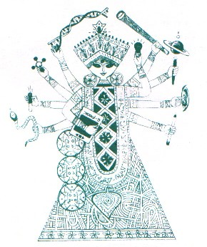
Gender and Precarities:
juggling precarious work, unstable relationships,
uncertain future scenarios and conflicting
social values

Slide 6
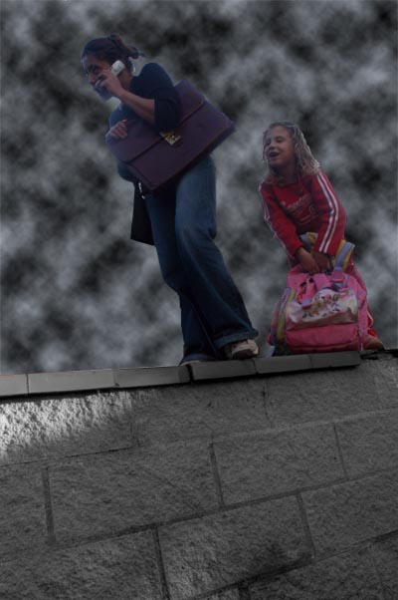
Different Precarities
Issues of time and space
la generation precaire
lives in economic insecurity
works off-hours
& needs to be mobile for
rapidly shifting job markets
yet the dominant institutional logic has not incorporated speed & flexibility in Italy
Notes:
Paradoxes of precarity,
Are you being rated user-friendly?

Slide 7
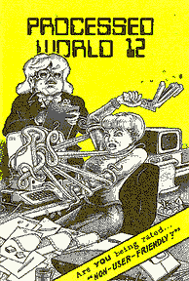
Gender and Precarities
Post industrial markets,
pre industrial institutions and values
the imperative of Flexibility clashes with
particularly persistent practices in ITALIAN society
Traditional family values
Strict gender & age roles to be respected
New forms of family arrangements
are feared and rejected

Slide 8
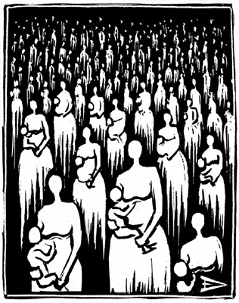
Gender and Precarities
Only recent
attention to gender difference
given in the political and
academic debates on precarity
(mainly in Europe)
This allowed to make the connection
with affective & reproductive issues
Raised in the 1970ies by radical autonomist feminists
useful angle to address citizenship & social welfare,
immigration & de-industrialization
Notes:
Not Just as unifying the “new” post-industrial European working-class.
(migrant domestic workers in Italy bring gender, racism & exploitation
into a feminist reading of precarity )

Slide 9
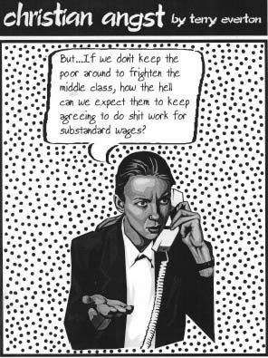
Different Precarities and the decline in life standards
lethal mix of temp work
for younger generation
& reduction & privatization of
social services
for children & elderly
middle-class families are squeezed
and
Respond by mobilizing all human
& financial resources
to maintain an average
living standard.
From best of temp slave (maxine holtz, p. 172)
Notes:
This class entered now a debt economy.

Slide 10
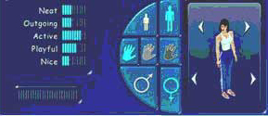
Different Precarities
A major effect of precarity is that young adults & elderly members live in the same household
⇓
MORE burden for
adult Italian
women
“the sandwich generation” in their 50ies or 60ies

Slide 11
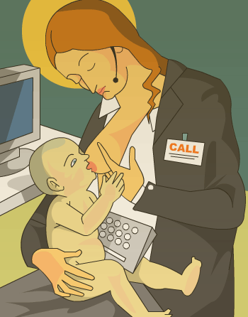
Different Precarities: Social reproduction for the the precarious generation
temp work
forces women to juggle material
& affective labour
with little recognition of such efforts
“in the 1970ies, many
feminists also struggled
To juggle work and care
but with a different
set of resources, and with more state welfare support, later eroded since the late 1980ies
Madonna del latte in customer-care center
Notes:
in second wave women’s movements it has been called “double shift” Hochshield and in Italy “double presence”
(Balbo 1978)

Slide 12
Different Precarities
2007-2012 old issues of the double shift/ care work and domestic work
Sparked new dialogues & alliances across feminist generations
We can see obvious differences between the post-war boom & today’s de-industrialization
education
autonomy
security
All these aspects present unresolved contradictions in today’s Italy

Slide 13
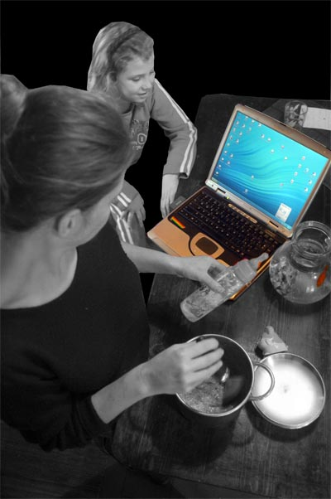
Gender and Precarity key political stances:
Politics of intersectionality::
considering multiple intergenerational and inter-ethnic exploitation
Multiple political subjectivity
refusing to engage in single-issue identity politics
performing both gendered care roles & intellectual labor
creativity and lifelong learning
Openness vs. stability
enthusiasm for an unpredictable, precarious life
Notes:
Main issues and demands

Slide 14
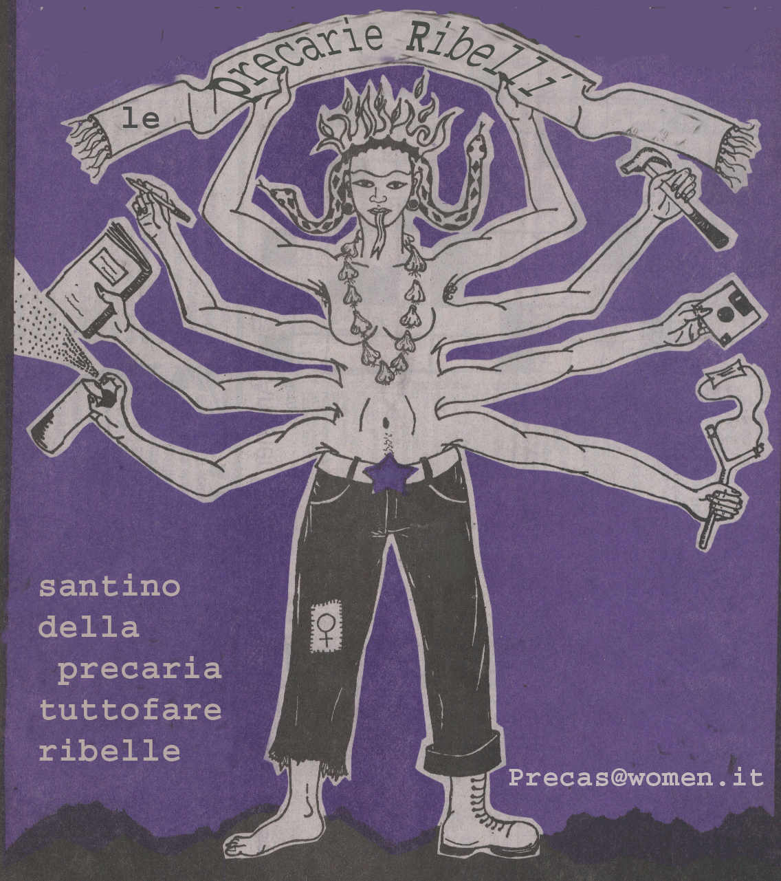
Gender and Precarities
Importance of
Communication
Strategies
In the last 10 years,
networks of young
feminists
Have discussed and “appropriated” precarity
inverting its negative connotations
with humor & provoking images
Notes:
Queer theory, using media and pop culture to describe a generational shift
avoiding the role of the weak and the victim.

Slide 15
Need to network resources and overcome shame and isolation:
Gender and Precarity
Develop new concepts and theories to express these contradictions
shamework is the sociological category that we wish to point to and break free from today (Borrowed from A. R. Hochschild, The commercialization of intimate life: notes from home and work, 2003)
definition: the amount of efforts, emotional work and time dedicated to hide, or render legible, and acceptable the lack of qualities taken for granted by a group we belong to

Slide 16
contradictory scenarios: Precariety/flexibility means
Gender and Precarity
Perception of increased freedom and independence
(all options are open)
BUT increased limitation welfare
more poverty
marriage
stable work, retirement
access to a mortgages
Buying a house
All sacred steps to adulthood::People younger than 40 in Italy can no longer live
BUT
the social pressure is still there for them
VS

Slide 17
Dilemmas of Precariety
Gender and Precarity
i.e.: the intellectual, creative work environment is not necessarily more
welcoming to women than others
the economically stable, educated middle-class learns to live by lower standards
REACTIONS AND RESPONSES
- the family and career options lead to saying yes to everything (work and family responsibilities)

Slide 18
RESPONSES TO Precariety/flexibility
Gender and Precarity
We can’ t say no to work,
we cant’ be choosy.. Our work is de-valued
Social reproduction is taken for granted: we can only think of making families if we accept a great deal of future uncertainties

Slide 19
Conclusion
Gender and Precarity
saying yes to any job
not distinguishing work from leisure
means
constant pressure and instability
high stress levels & frustration
persisting sense of shame and isolation
all with major effects on our health

